Slide 1
Building Java Programs Chapter 2
Primitive Data and Definite Loops

Slide 2
Data types
Type: A category or set of data values.
Constrains the operations that can be performed on data
Many languages ask the programmer to specify types
Examples: integer, real number, string
Internally, computers store everything as 1s and 0s
104 → 01101000
"hi" → 01101000110101

Slide 3
Java's primitive types
Primitive types: 8 simple types for numbers, text, etc.
Java also has object types, which we'll talk about later
Name Description Examples
int integers (up to 2³¹ - 1) 42, -3, 0, 926394
double real numbers (up to 10³⁰⁸) 3.1, -0.25, 9.4e3
char single text characters 'a', 'X', '?', '\n'
boolean logical values true, false

Slide 4
Expressions
Expression: A value or operation that computes a value.
Examples: 1 + 4 * 5
(7 + 2) * 6 / 3
42
The simplest expression is a literal value.
A complex expression can use operators and parentheses.

Slide 5
Arithmetic operators
Operator: Combines multiple values or expressions.
+ addition
- subtraction (or negation)
* multiplication
/ division
% modulus (a.k.a. remainder)
As a program runs, its expressions are evaluated.
1 + 1 evaluates to 2
System.out.println(3 * 4); prints 12
How would we print the text 3 * 4 ?

Slide 6
Integer division with /
When we divide integers, the quotient is also an integer.
14 / 4 is 3, not 3.5
3 4 52
4 ) 14 10 ) 45 27 ) 1425
12 40 135
2 5 75
54
21
More examples:
32 / 5 is 6
84 / 10 is 8
156 / 100 is 1
Dividing by 0 causes an error when your program runs.

Slide 7
Integer remainder with %
The % operator computes the remainder from integer division.
14 % 4 is 2
218 % 5 is 3 3 43 4 ) 14 5 ) 218 12 20 2 18 15 3
Applications of % operator:
Obtain last digit of a number: 230857 % 10 is 7
Obtain last 4 digits: 658236489 % 10000 is 6489
See whether a number is odd: 7 % 2 is 1, 42 % 2 is 0
What is the result?
45 % 6
2 % 2
8 % 20
11 % 0

Slide 8
Precedence
Precedence: Order in which operators are evaluated.
Generally operators evaluate left-to-right. 1 - 2 - 3 is (1 - 2) - 3 which is -4
But * / % have a higher level of precedence than + - 1 + 3 * 4 is 13
6 + 8 / 2 * 3
6 + 4 * 3
6 + 12 is 18
Parentheses can force a certain order of evaluation: (1 + 3) * 4 is 16
Spacing does not affect order of evaluation 1+3 * 4-2 is 11

Slide 9
Precedence examples
1 * 2 + 3 * 5 % 4
\_/ | 2 + 3 * 5 % 4
\_/ | 2 + 15 % 4
\___/ | 2 + 3
\________/ | 5
1 + 8 % 3 * 2 - 9
\_/ | 1 + 2 * 2 - 9
\___/ | 1 + 4 - 9
\______/ | 5 - 9
\_________/ | -4

Slide 10
Real numbers (type double)
Examples: 6.022 , -42.0 , 2.143e17
Placing .0 or . after an integer makes it a double.
The operators + - * / % () all still work with double.
/ produces an exact answer: 15.0 / 2.0 is 7.5
Precedence is the same: () before * / % before + -

Slide 11
Mixing types
When int and double are mixed, the result is a double.
4.2 * 3 is 12.6
The conversion is per-operator, affecting only its operands.
7 / 3 * 1.2 + 3 / 2
\_/ | 2 * 1.2 + 3 / 2
\___/ | 2.4 + 3 / 2
\_/ | 2.4 + 1
\________/ | 3.4
3 / 2 is 1 above, not 1.5.
2.0 + 10 / 3 * 2.5 - 6 / 4
\___/ | 2.0 + 3 * 2.5 - 6 / 4
\_____/ | 2.0 + 7.5 - 6 / 4
\_/ | 2.0 + 7.5 - 1
\_________/ | 9.5 - 1
\______________/ | 8.5

Slide 12
String concatenation
String concatenation: Using + between a string and another value to make a longer string.
"hello" + 42 is "hello42"
1 + "abc" + 2 is "1abc2"
"abc" + 1 + 2 is "abc12"
1 + 2 + "abc" is "3abc"
"abc" + 9 * 3 is "abc27"
"1" + 1 is "11"
4 - 1 + "abc" is "3abc"
Use + to print a string and an expression's value together.
System.out.println("Grade: " + (95.1 + 71.9) / 2);
Output: Grade: 83.5

Slide 13
Variables

Slide 14

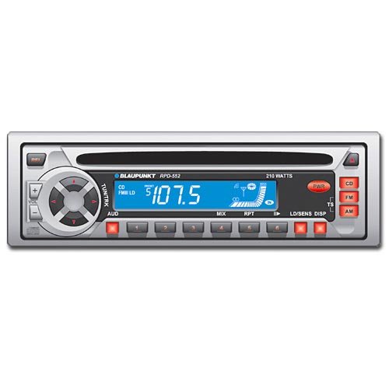
Variables
Variable: A piece of the computer's memory that is given a name and type, and can store a value.
Like preset stations on a car stereo, or cell phone speed dial:
Steps for using a variable:
Declare it - state its name and type
Initialize it - store a value into it
Use it - print it or use it as part of an expression

Slide 15
Declaration
Variable declaration: Sets aside memory for storing a value.
Variables must be declared before they can be used.
Syntax:
type name;
The name is an identifier.
int x;
double myGPA;
x
myGPA

Slide 16
Assignment
Assignment: Stores a value into a variable.
The value can be an expression; the variable stores its result.
Syntax:
name = expression;
int x; x = 3;
double myGPA; myGPA = 1.0 + 2.25;
x | 3
myGPA | 3.25

Slide 17
Using variables
Once given a value, a variable can be used in expressions:
int x;
x = 3;
System.out.println("x is " + x); // x is 3
System.out.println(5 * x - 1); // 5 * 3 - 1
You can assign a value more than once:
int x; x = 3; System.out.println(x + " here"); // 3 here x = 4 + 7; System.out.println("now x is " + x); // now x is 11
x | 11

Slide 18
Declaration/initialization
A variable can be declared/initialized in one statement.
Syntax:
type name = value;
double myGPA = 3.95;
int x = (11 % 3) + 12;
myGPA | 3.95
x | 14

Slide 19
Assignment and algebra
Assignment uses = , but it is not an algebraic equation.
= means, "store the value at right in variable at left"
The right side expression is evaluated first, and then its result is stored in the variable at left.
What happens here?
int x = 3;
x = x + 2; // ???
x | 5

Slide 20
Assignment and types
A variable can only store a value of its own type.
int x = 2.5; // ERROR: incompatible types
An int value can be stored in a double variable.
The value is converted into the equivalent real number.
double myGPA = 4;
double avg = 11 / 2;
Why does avg store 5.0 and not 5.5 ?
myGPA | 4.0
avg | 5.0

Slide 21
Compiler errors
A variable can't be used until it is assigned a value.
int x;
System.out.println(x); // ERROR: x has no value
You may not declare the same variable twice.
int x; int x; // ERROR: x already exists
int x = 3; int x = 5; // ERROR: x already exists
How can this code be fixed?

Slide 22
Printing a variable's value
Use + to print a string and a variable's value on one line.
double grade = (95.1 + 71.9 + 82.6) / 3.0;
System.out.println("Your grade was " + grade);
int students = 11 + 17 + 4 + 19 + 14;
System.out.println("There are " + students +
" students in the course.");
Output:
Your grade was 83.2
There are 65 students in the course.

Slide 23
The for loop

Slide 24
for loop syntax
for (initialization; test; update) {
statement;
statement;
...
statement;
}
Perform initialization once.
Repeat the following:
Check if the test is true. If not, stop.
Execute the statements.
Perform the update.

Slide 25
Initialization
for (int i = 1; i <= 6; i++) {
System.out.println("I am so smart");
}
Tells Java what variable to use in the loop
Performed once as the loop begins
The variable is called a loop counter
can use any name, not just i
can start at any value, not just 1

Slide 26
Test
for (int i = 1; i <= 6; i++) {
System.out.println("I am so smart");
}
Tests the loop counter variable against a limit
Uses comparison operators:
< less than
<= less than or equal to
> greater than
>= greater than or equal to

Slide 27
Increment and decrement
shortcuts to increase or decrease a variable's value by 1
Shorthand Equivalent longer version
variable++; variable = variable + 1;
variable--; variable = variable - 1;
int x = 2;
x++; // x = x + 1;
// x now stores 3
double gpa = 2.5;
gpa--; // gpa = gpa - 1;
// gpa now stores 1.5

Slide 28
Modify-and-assign
shortcuts to modify a variable's value
Shorthand Equivalent longer version
variable += value; variable = variable + value;
variable -= value; variable = variable - value;
variable *= value; variable = variable * value;
variable /= value; variable = variable / value;
variable %= value; variable = variable % value;
x += 3; // x = x + 3;
gpa -= 0.5; // gpa = gpa - 0.5;
number *= 2; // number = number * 2;

Slide 29
Repetition over a range
System.out.println("1 squared = " + 1 * 1);
System.out.println("2 squared = " + 2 * 2);
System.out.println("3 squared = " + 3 * 3);
System.out.println("4 squared = " + 4 * 4);
System.out.println("5 squared = " + 5 * 5);
System.out.println("6 squared = " + 6 * 6);
Intuition: "I want to print a line for each number from 1 to 6"
The for loop does exactly that!
for (int i = 1; i <= 6; i++) {
System.out.println(i + " squared = " + (i * i));
}
"For each integer i from 1 through 6, print ..."

Slide 30
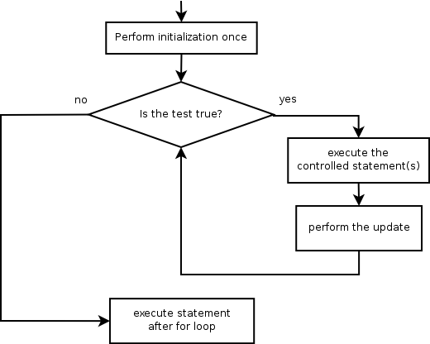
Loop walkthrough
1
2
3
for (int i = 1; i <= 4; i++) {
System.out.println(i + " squared = " + (i * i));
}
System.out.println("Whoo!");
Output:
1 squared = 1
2 squared = 4
3 squared = 9
4 squared = 16
Whoo!
4
1
2
3
4

Slide 31
Multi-line loop body
System.out.println("+----+");
for (int i = 1; i <= 3; i++) {
System.out.println("\\ /");
System.out.println("/ \\");
}
System.out.println("+----+");
Output:
+----+
\ /
/ \
\ /
/ \
\ /
/ \
+----+

Slide 32
Expressions for counter
int highTemp = 5;
for (int i = -3; i <= highTemp / 2; i++) {
System.out.println(i * 1.8 + 32);
}
Output:
26.6 28.4 30.2 32.0 33.8 35.6

Slide 33
System.out.print
Prints without moving to a new line
allows you to print partial messages on the same line
int highestTemp = 5;
for (int i = -3; i <= highestTemp / 2; i++) {
System.out.print((i * 1.8 + 32) + " ");
}
Output:
26.6 28.4 30.2 32.0 33.8 35.6
Concatenate " " to separate the numbers

Slide 34
Nested for loops

Slide 35
Nested loops
Nested loop: A loop placed inside another loop.
for (int i = 1; i <= 5; i++) {
for (int j = 1; j <= 10; j++) {
System.out.print("*");
}
System.out.println(); // to end the line
}
Output:
**********
**********
**********
**********
**********
The outer loop repeats 5 times; the inner one 10 times.
"sets and reps" exercise analogy

Slide 36
Nested for loop exercise
What is the output of the following nested for loops?
for (int i = 1; i <= 5; i++) {
for (int j = 1; j <= i; j++) {
System.out.print("*");
}
System.out.println();
}
Output:
*
**
***
****
*****

Slide 37
Nested for loop exercise
What is the output of the following nested for loops?
for (int i = 1; i <= 5; i++) {
for (int j = 1; j <= i; j++) {
System.out.print(i);
}
System.out.println();
}
Output:
1
22
333
4444
55555

Slide 38
Class constants and scope

Slide 39
Limitations of variables
Idea: Make a variable to represent the size.
Use the variable's value in the methods.
Problem: A variable in one method can't be seen in others.
public static void main(String[] args) {
int size = 4;
topHalf();
printBottom();
}
public static void topHalf() {
for (int i = 1; i <= size; i++) { // ERROR: size not found
...
}
}
public static void bottomHalf() {
for (int i = size; i >= 1; i--) { // ERROR: size not found
...
}
}

Slide 40
Scope
Scope: The part of a program where a variable exists.
From its declaration to the end of the { } braces
A variable declared in a for loop exists only in that loop.
A variable declared in a method exists only in that method.
public static void example() {
int x = 3;
for (int i = 1; i <= 10; i++) {
System.out.println(x);
}
// i no longer exists here
} // x ceases to exist here

Slide 41
Scope implications
Variables without overlapping scope can have same name.
for (int i = 1; i <= 100; i++) {
System.out.print("/");
}
for (int i = 1; i <= 100; i++) { // OK
System.out.print("\\");
}
int i = 5; // OK: outside of loop's scope
A variable can't be declared twice or used out of its scope.
for (int i = 1; i <= 100 * line; i++) {
int i = 2; // ERROR: overlapping scope
System.out.print("/");
}
i = 4; // ERROR: outside scope

Slide 42
Class constants
Class constant: A fixed value visible to the whole program.
value can be set only at declaration; cannot be reassigned
Syntax:
public static final type name = value;
name is usually in ALL_UPPER_CASE
Examples:
public static final int DAYS_IN_WEEK = 7;
public static final double INTEREST_RATE = 3.5;
public static final int SSN = 658234569;

